Slide 1
Airline Safety Out-Performs Automobiles
Bret Young
DSC 640
Executive Summary

Slide 2
Overview
Comparison of fatalities to cars
Fatal incidents by airline
Fatalities by airline
Fatalities by location
Airline profits and fuel
Summary
Resources
Data Sources

Slide 3
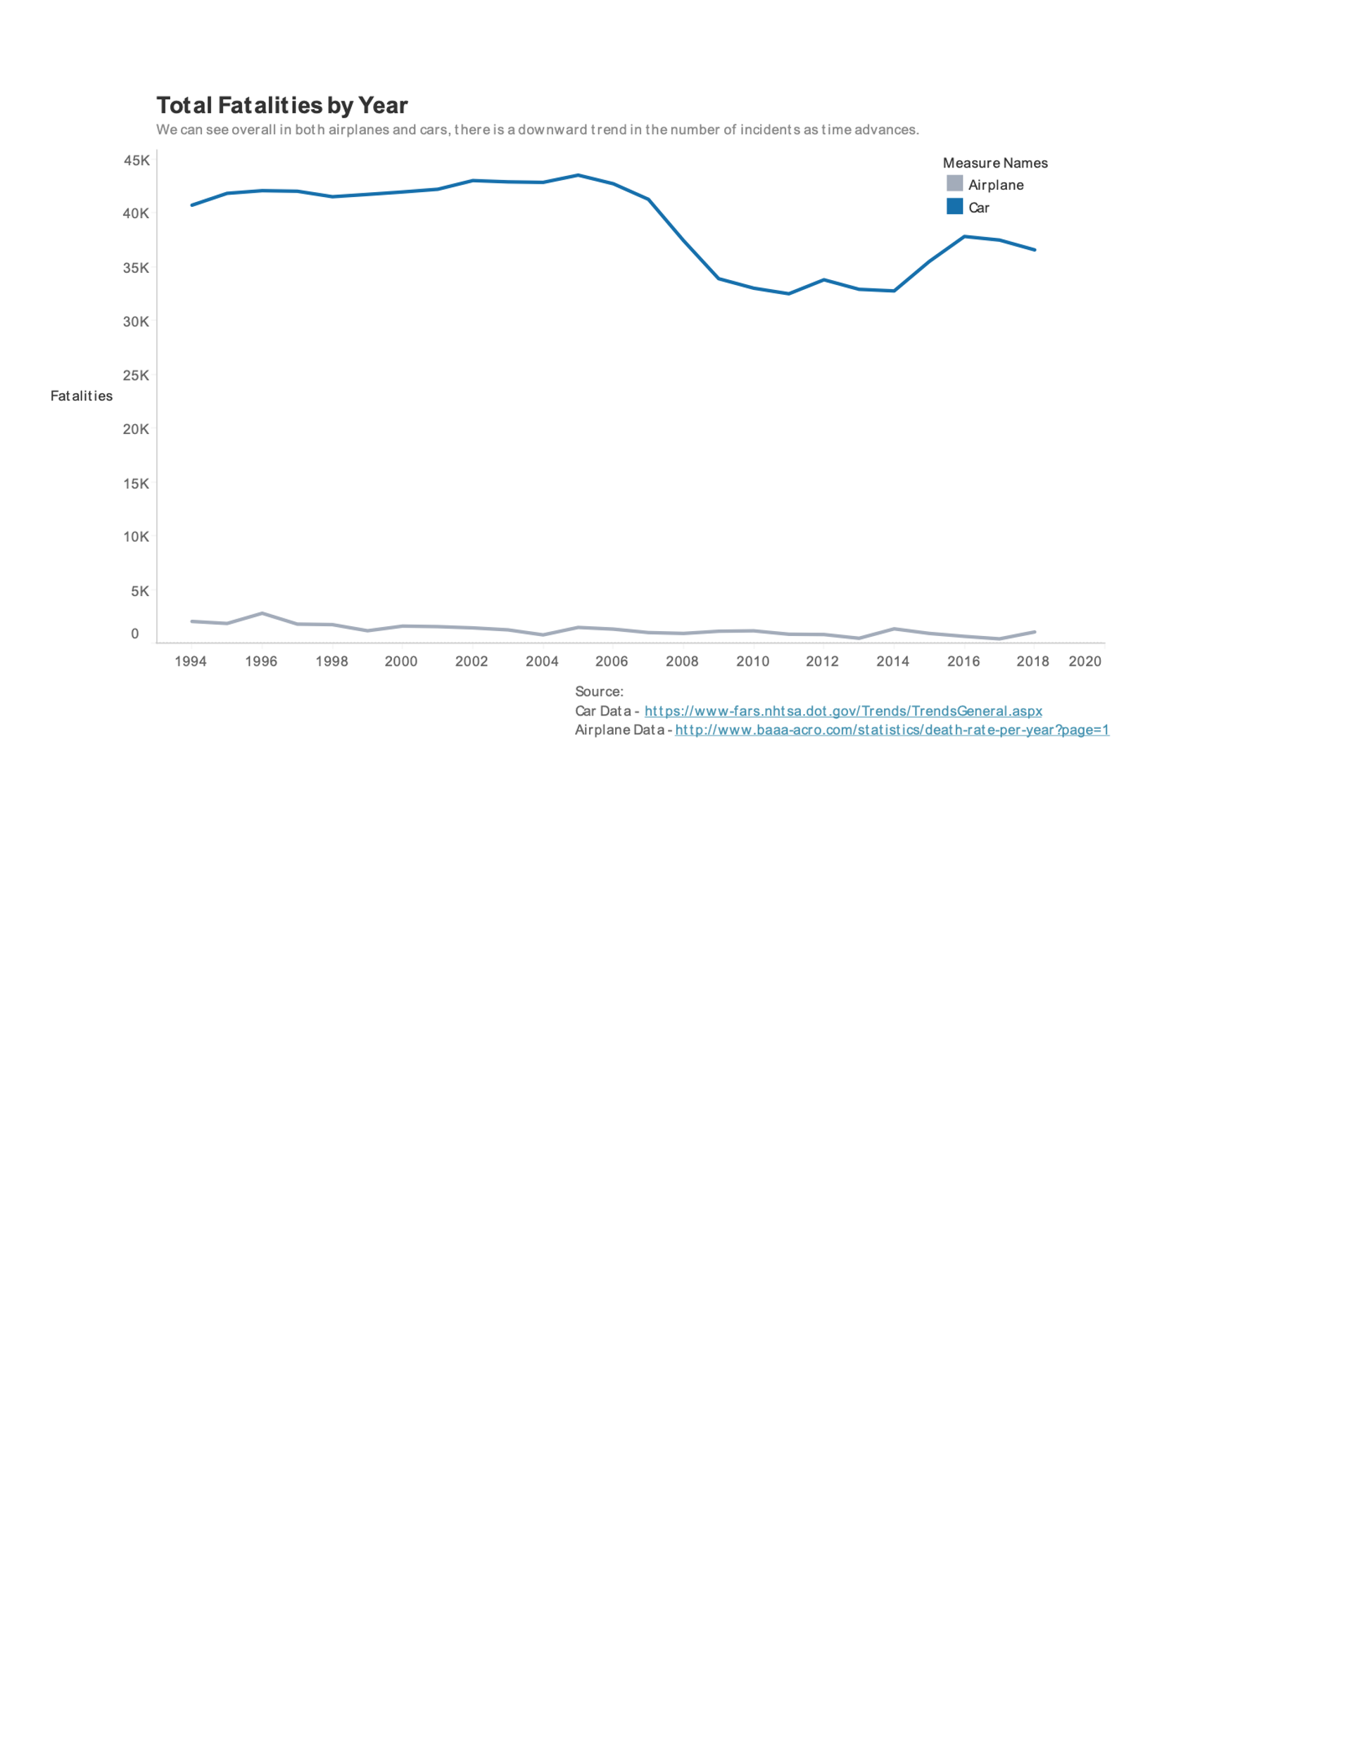
Fatalities Per Year
Car fatalities are those reported for the United States by National Highway Traffic Safety Administration
Large gap between cars and airplanes
Airplanes trend down entire span
Cars see large decrease in 2008 but still much higher

Slide 4
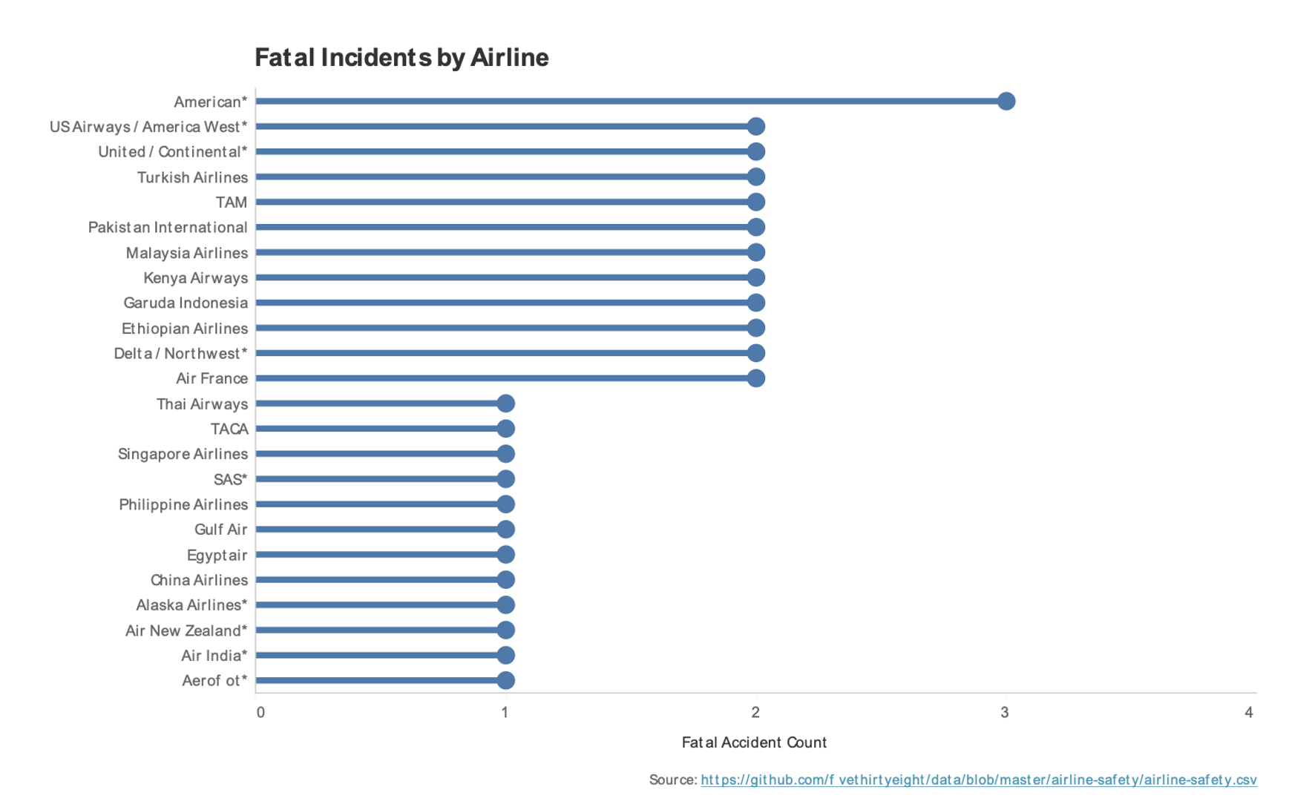
Incidents Per Airline
1994 thru 2018
Most incidents per airline is 3
Not very high considering number of airplanes seen in skies daily
Airlines with 0 reported incidents filtered out

Slide 5
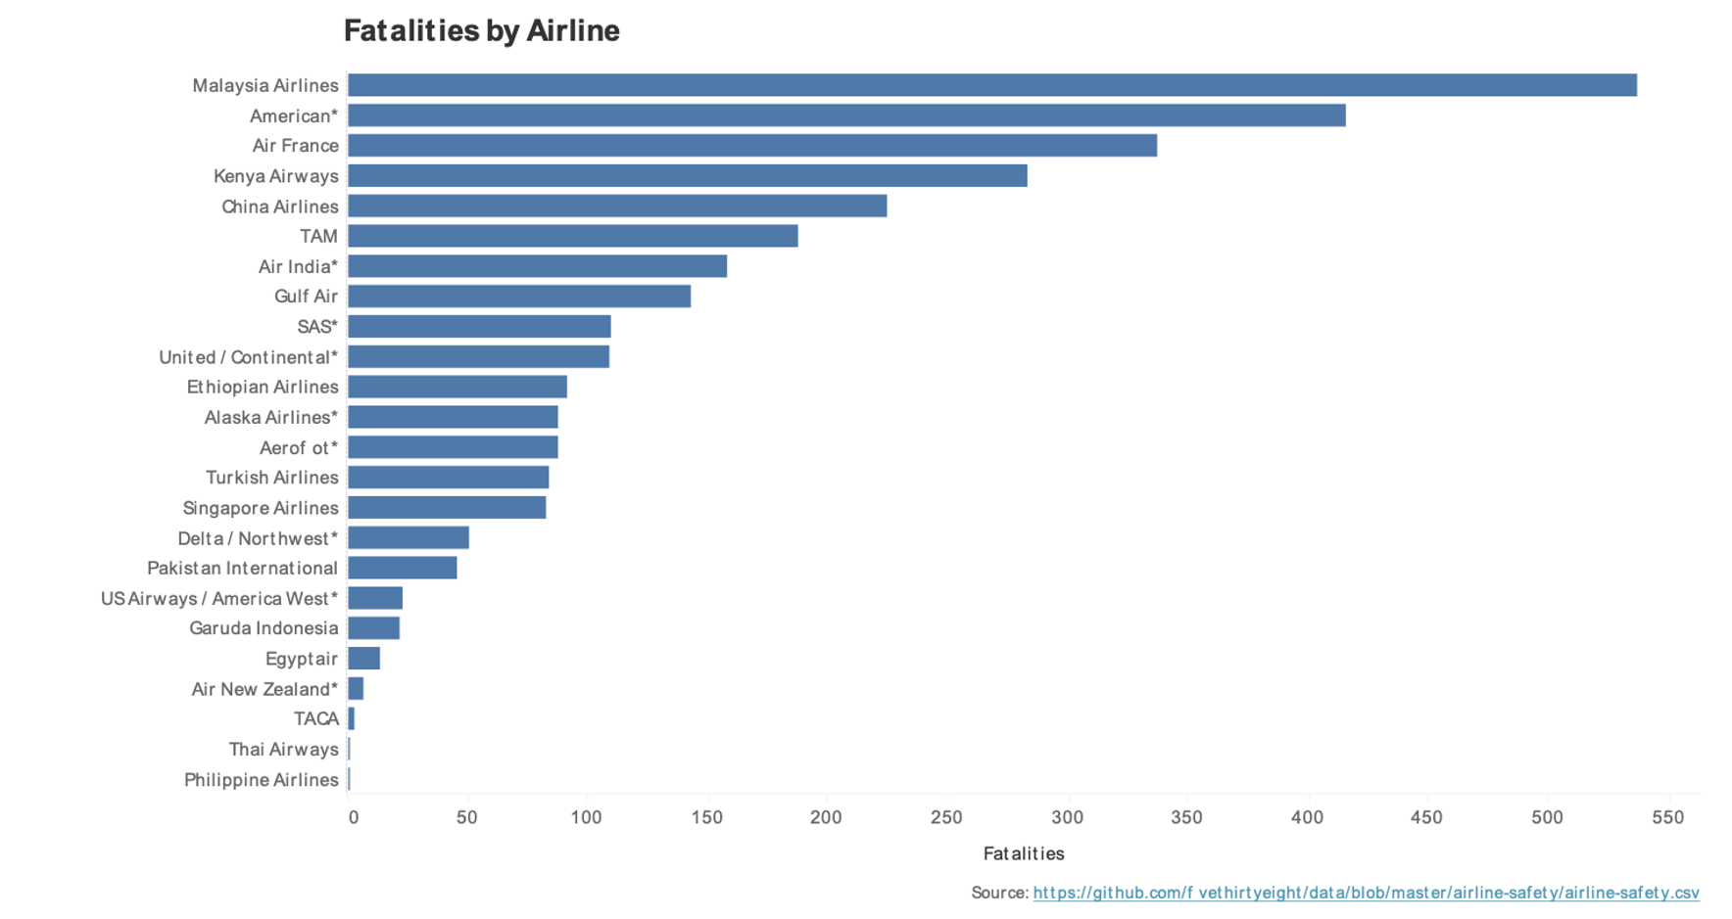
Fatalities Per Airline
Malaysia airlines had 2 planes crash
2 American and 1 United plane involved in 2001 attacks

Slide 6
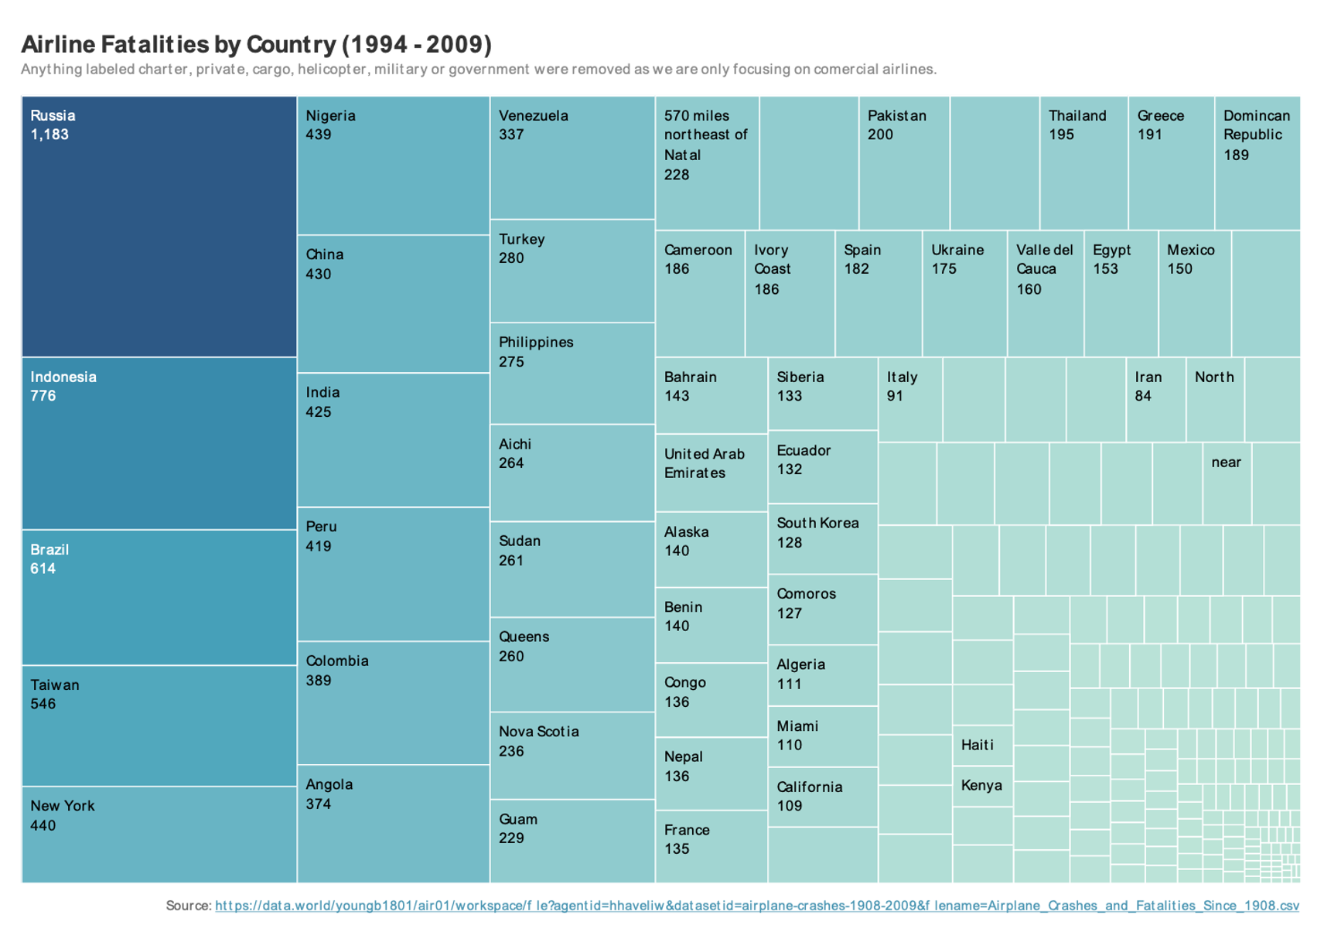
Fatalities By Location
Russia has almost double that of any other location
Removed carrier, military, helicopter and private aircraft

Slide 7
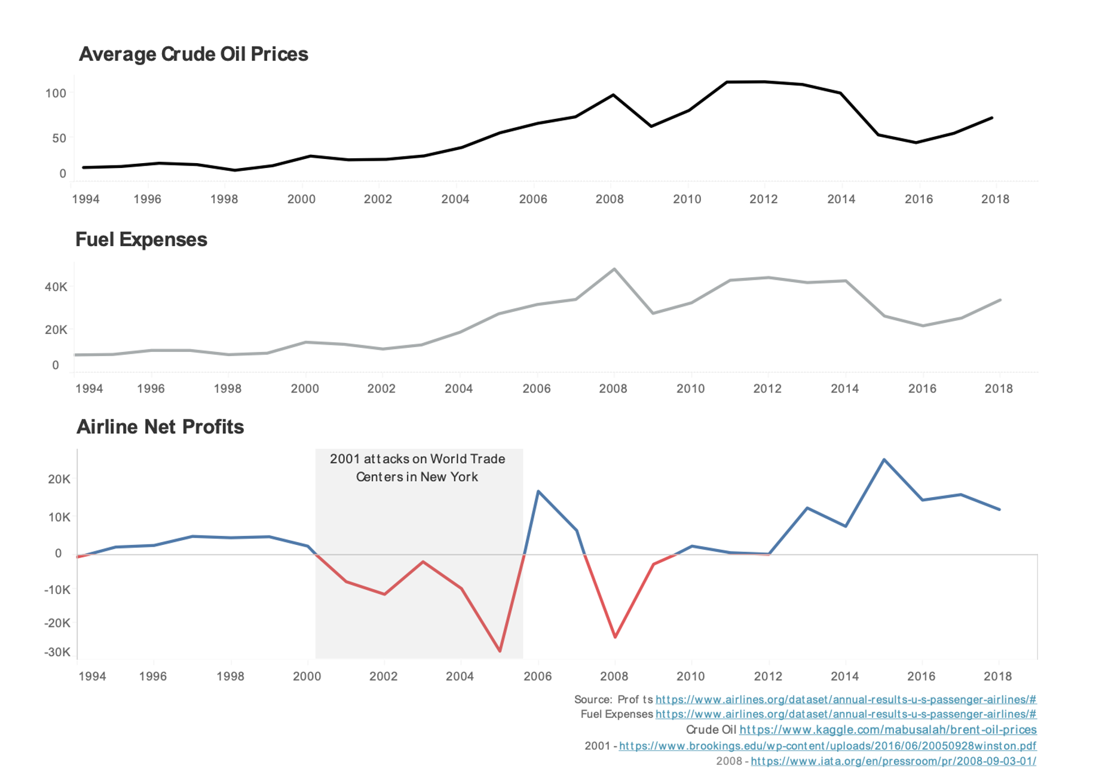
Profits
Profits decline significantly after large events like 2001 attacks
Profits decrease with unexpected oil price increases
Fuel expenses and oil prices follow same basic trend

Slide 8
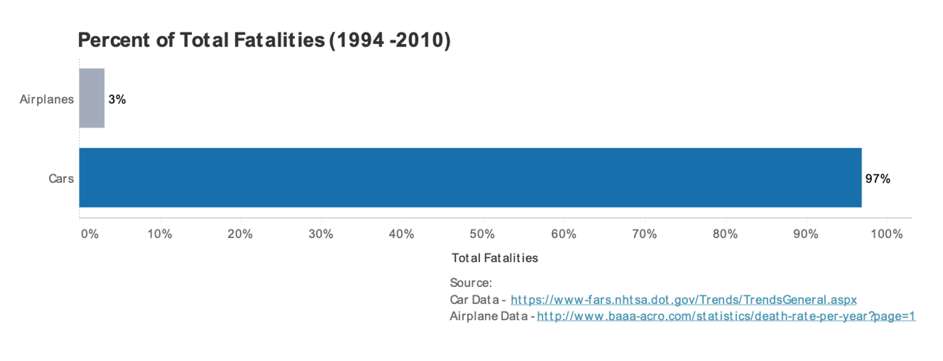
Summary
Airline incidents are much less than automobiles, only 3%
Airline incidents tend to have more fatalities per incident due to more passengers
Malaysia has highest number of fatalities for airlines
American has most incidents with 3
Russia has highest fatalities compared to other locations
Profits are lower when crude oil price is higher
Large incidents involving airplanes cause less travel, e.g. 2001 attacks on Trade Centers
Number of fatalities per year is decreasing for industry
Thank you!

Slide 9
Resources
International Air Transport Association. (2008, September 3). Airlines to lose US$5.2 billion in 2008 - Slowing Demand and High Oil to Blame. Retrieved September 21, 2020, from iata.org: https://www.iata.org/en/pressroom/pr/2008-09-03-01/
Morrison, S. W. (2005, September 28). What’s Wrong with the Airline Industry? Diagnosis and Possible Cures. Retrieved Septemper 21, 2020, from Brooking.org: https://www.brookings.edu/wp-content/uploads/2016/06/20050928winston.pdf

Slide 10
Data Sources
airline-safety.csv - https://github.com/fivethirtyeight/data/tree/master/airline-safety
Airplane Fatalities by Year 1918-2019.csv - http://www.baaa-acro.com/statistics/death-rate-per-year
Airplane_Crashes_and_Fatalities_Since_1908.csv - https://data.world/youngb1801/air01/workspace/file?agentid=hhaveliw&datasetid=airplane-crashes-1908-2009&filename=Airplane_Crashes_and_Fatalities_Since_1908.csv
Cars_94-18.csv - https://www-fars.nhtsa.dot.gov/Trends/TrendsGeneral.aspx
Financials.pdf - https://www.airlines.org/dataset/annual-results-u-s-passenger-airlines/#
Crude Oil Prices - https://www.kaggle.com/mabusalah/brent-oil-prices

